Slide 1
Digital Portfolio
STUDENT NAME: NITHEESH KUMAR.S
REGISTER NO AND NMID: 2428BO331/82CCA6727F2A3D89C3B4E32C1BECC2B5
DEPARTMENT: Bsc computer science with data analytics
COLLEGE: KPR college of arts science and research/Bharathiar university

Slide 2
PROJECT TITLE Creative Side Projects

Slide 3


AGENDA
Problem Statement
Project Overview
End Users
Tools and Technologies
Portfolio design and Layout
Features and Functionality
Results and Screenshots
Conclusion
Github Link
3/21/2024 Annual Review

Slide 4

PROBLEM STATEMENT There is a need for a professional and structured way to showcase skills, achievements, and projects. Traditional resumes often fail to demonstrate creativity and technical ability effectively. A Digital Portfolio bridges this gap by providing a more interactive and modern presentation of one’s profile.

Slide 5

PROJECT OVERVIEW This project is a Digital Portfolio system that allows students and professionals to display their profile, skills, academic achievements, and projects in a clean and well-designed format.

Slide 6

WHO ARE THE END USERS? 1.Students preparing for placements 2.Job seekers wanting to showcase their work 3.Recruiters looking for candidate details quickly 4.Academic institutions evaluating student projects

Slide 7

TOOLS AND TECHNIQUES Frontend: HTML, CSS, javaScript Version Control: GitHub Presentation: PPT/Portfolio

Slide 8
POTFOLIO DESIGN AND LAYOUT
Clean and professional interface
Sections divided into profile, skills, projects, and results
Easy navigation for end users
Visual elements for better engagement
8

Slide 9
FEATURES AND FUNCTIONALITY
Allows users to experiment with small innovative ideas using coding and design.
Provides a platform to practice HTML, CSS, and JavaScript in real-world mini projects.
Focuses on interactivity, creativity, and problem-solving skills.
Each project demonstrates unique features such as animations, random generators, or dynamic UI elements.
Helps in improving coding confidence and building a portfolio of side projects.

Slide 10
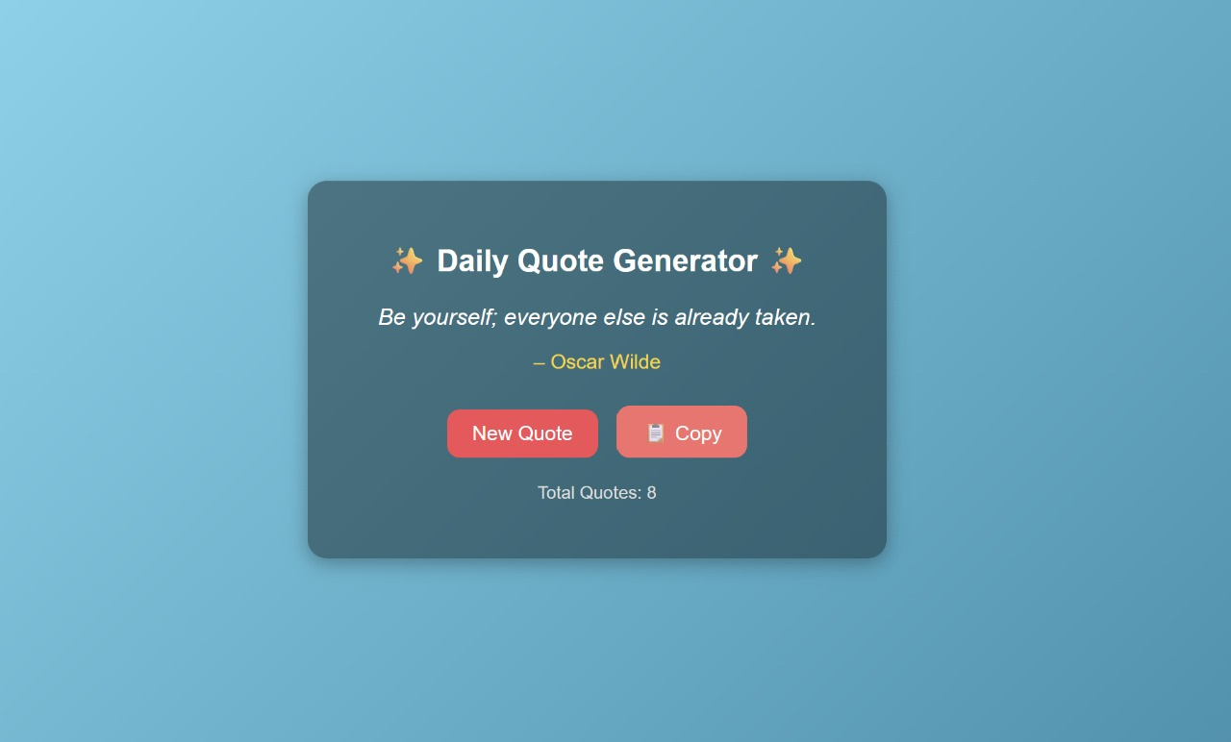

RESULTS AND SCREENSHOTS
The digital portfolio was successfully created with a clean and professional layout.
It includes all key sections such as profile, projects, results, and external links.
The portfolio design ensures easy navigation and provides visual proof through screenshots.
3/21/2024 Annual Review
10

Slide 11
CONCLUSION
The Digital Portfolio project successfully demonstrates the importance of presenting skills, projects, and achievements in a structured and professional manner. Unlike traditional resumes, the portfolio provides an interactive and visually appealing platform that highlights both technical expertise and creativity. It ensures easy navigation for end users such as recruiters, institutions, and professionals, making it an effective career-building tool.
11

Slide 12
GITHUB LINK
https://nnitheesh863-maker.github.io/nitheeesh82/

